Slide 1
GETTING THE MOST OUT OF A SERMON
By John Ames

Slide 2
Changing Lives
Through
God’s Word

Slide 3
PREPARING TO WRITE A SERMON
STEP 1)
PRAYER___
AND MORE PRAYER

Slide 4

The only way we know what to say is through the Holy Spirit

Slide 5
John 14:26
26 But the Advocate, the Holy Spirit, whom the Father will send in my name, will teach you all things and will remind you of everything I have said to you.

Slide 6
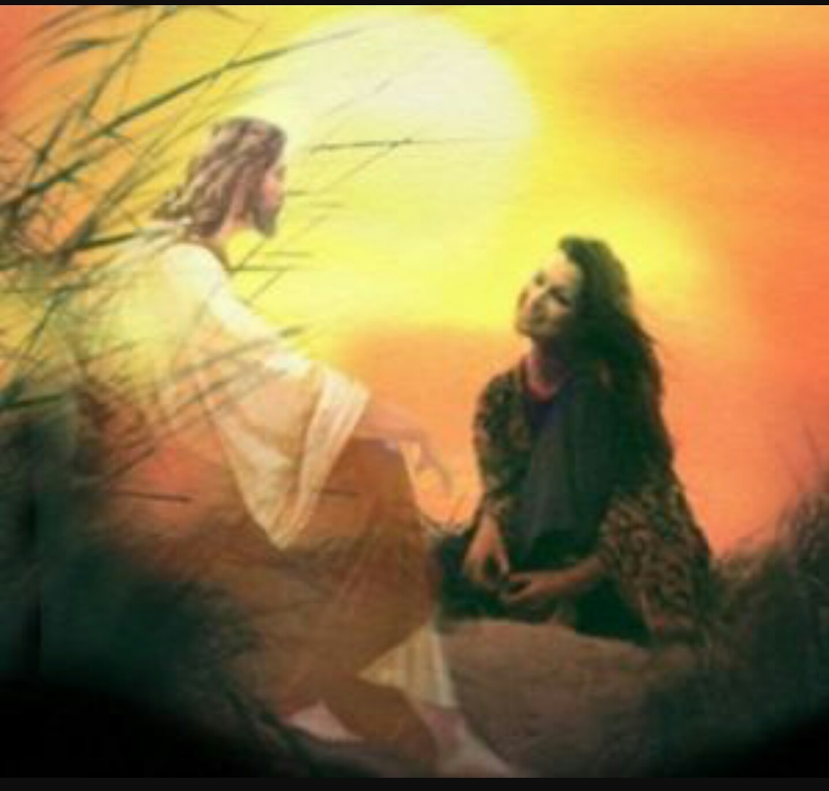

Slide 7
Acts 1:8 ESV
But you will receive power when the Holy Spirit has come upon you, and you will be my witnesses in Jerusalem and in all Judea and Samaria, and to the end of the earth.”

Slide 8
WE ARE KINDA LIKE A MIDDLE MAN

Slide 9
We cannot make you change and be more like Jesus!!!
But the word of God can

Slide 10
And the point of this message is that I would like to share a few of the sermons that I have heard over the years that have really touched my heart.

Slide 11
The first one goes back about 8 years ago. The new jail had just opened and pastor Jack was doing the service, and the subject he was teaching on was about David and Goliath.

Slide 12
I am not going to get into the whole story, but if you would like to read a great story on faith!
1 Samuel 17

Slide 13
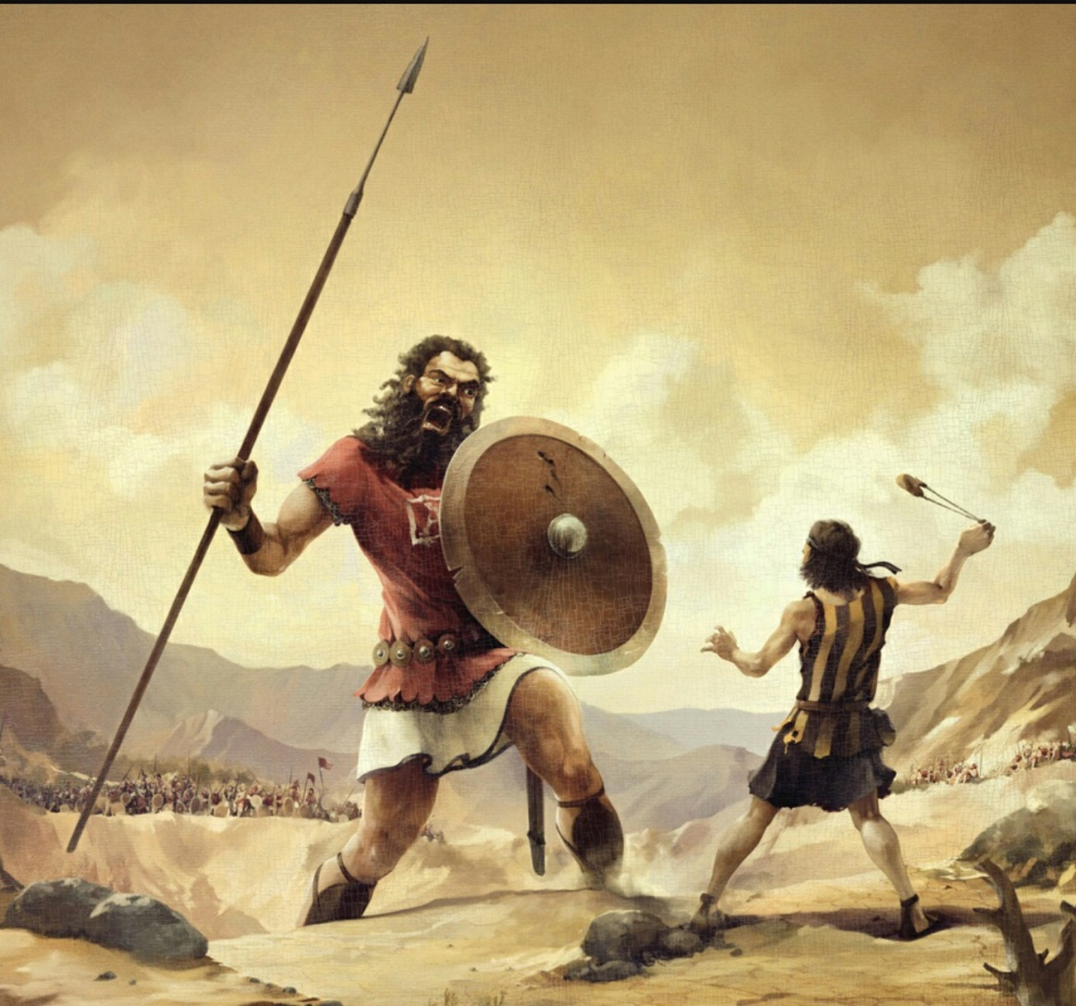

Slide 14
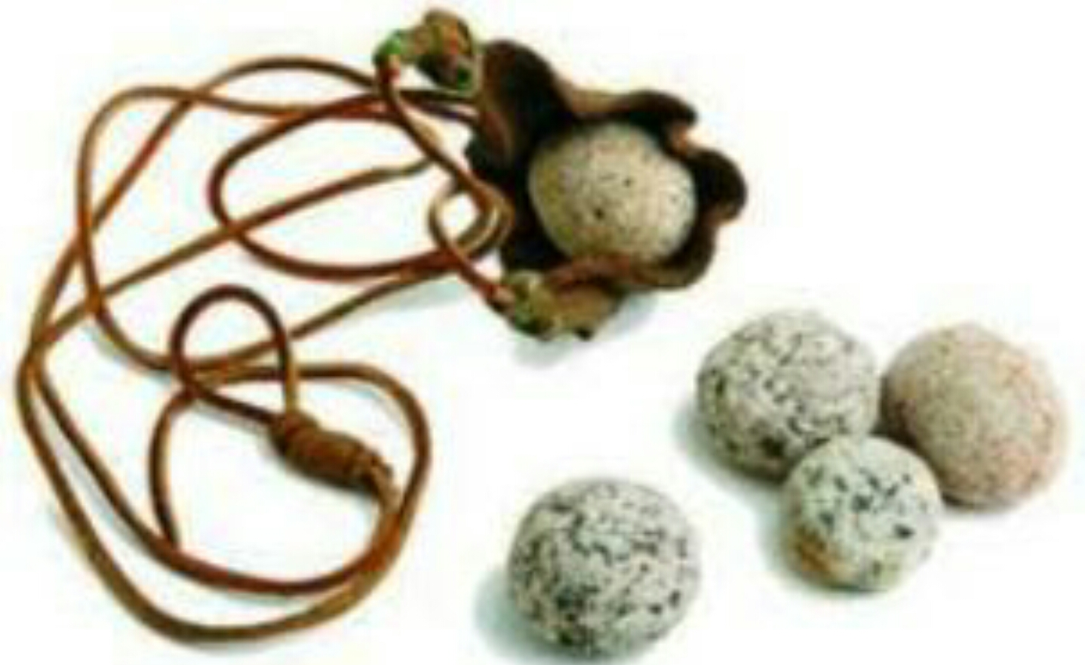
38 Then Saul dressed David in his own tunic. He put a coat of armor on him and a bronze helmet on his head.

Slide 15
39 David fastened on his sword over the tunic and tried walking around, because he was not used to them.
“I cannot go in these,” he said to Saul, “because I am not used to them.” So he took them off.

Slide 16
40 Then he took his staff in his hand, chose five smooth stones from the stream, put them in the pouch of his shepherd’s bag and, with his sling in his hand, approached the Philistine.

Slide 17
41 Meanwhile, the Philistine, with his shield bearer in front of him, kept coming closer to David.

Slide 18
42 He looked David over and saw that he was little more than a boy, glowing with health and handsome, and he despised him.

Slide 19
43 He said to David, “Am I a dog, that you come at me with sticks?” And the Philistine cursed David by his gods.

Slide 20
44 “Come here,” he said, “and I’ll give your flesh to the birds and the wild animals!”

Slide 21
45 David said to the Philistine, “You come against me with sword and spear and javelin, but I come against you in the name of the Lord Almighty, the God of the armies of Israel, whom you have defied.

Slide 22
46 This day the Lord will deliver you into my hands, and I’ll strike you down and cut off your head. This very day I will give the carcasses of the Philistine army to the birds and the wild animals, and the whole world will know that there is a God in Israel.

Slide 23
47 All those gathered here will know that it is not by sword or spear that the Lord saves; for the battle is the Lord’s, and he will give all of you into our hands.”

Slide 24
48 As the Philistine moved closer to attack him, David ran quickly toward the battle line to meet him.

Slide 25
49 Reaching into his bag and taking out a stone, he slung it and struck the Philistine on the forehead. The stone sank into his forehead, and he fell facedown on the ground.

Slide 26
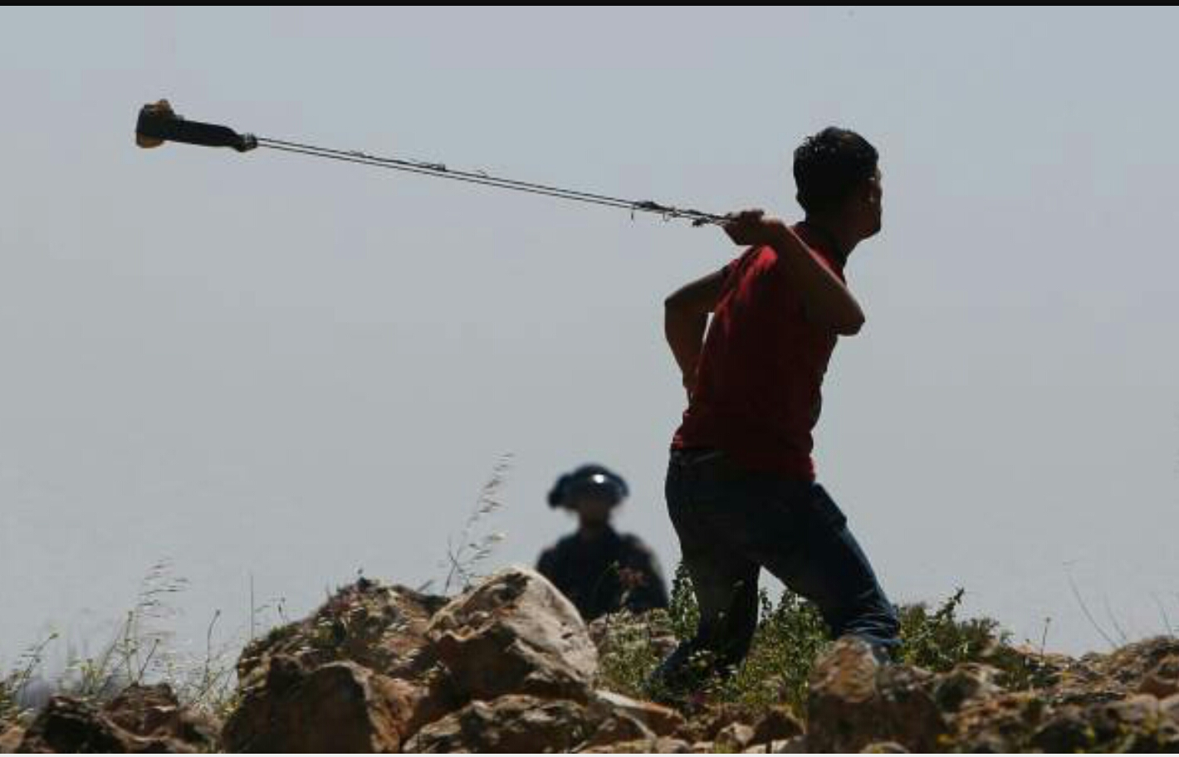

Slide 27
50 So David triumphed over the Philistine with a sling and a stone; without a sword in his hand he struck down the Philistine and killed him.

Slide 28
51 David ran and stood over him. He took hold of the Philistine’s sword and drew it from the sheath. After he killed him, he cut off his head with the sword.

Slide 29
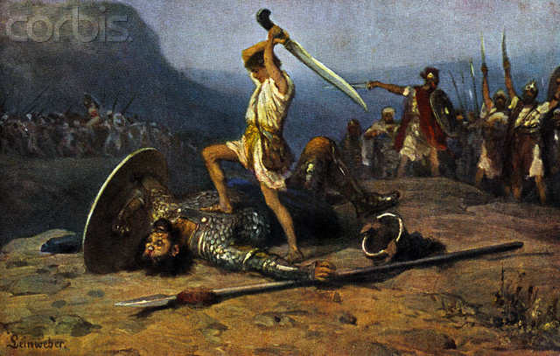
Pastor Jack told the group that David threw his trust in God at Goliath and was victorious!

Slide 30
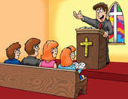
Pastor Jack asks the group what are you throwing
At your GIANTS

Slide 31
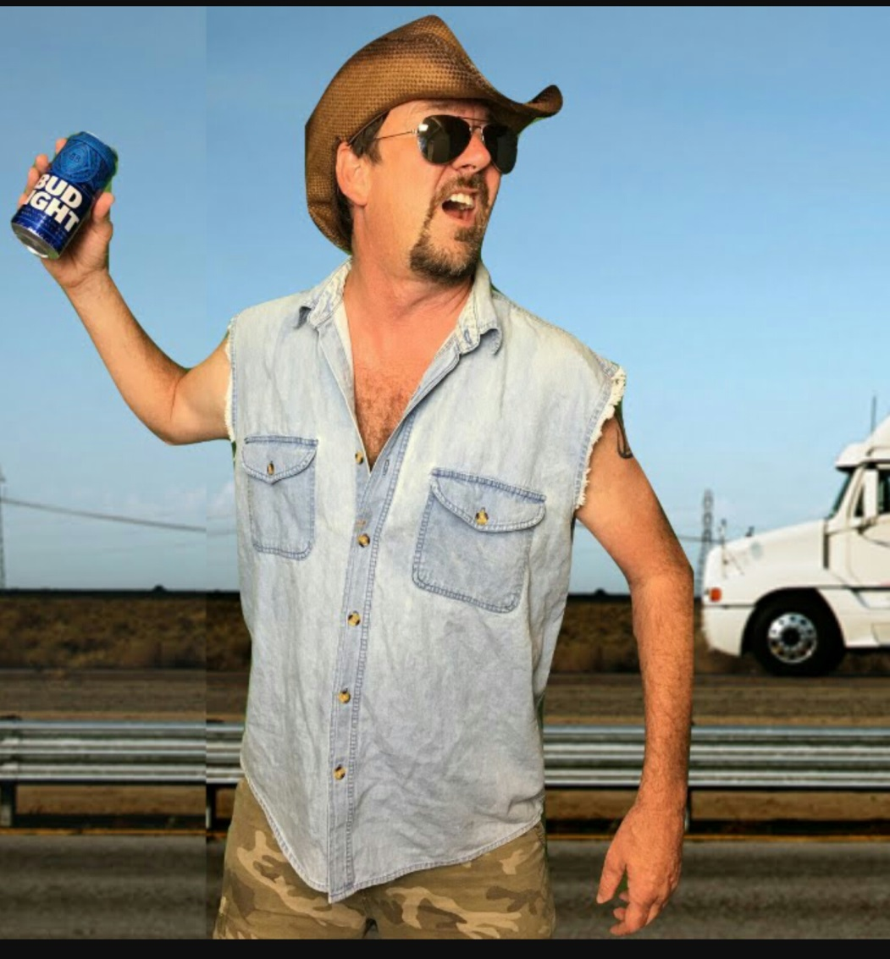
One young man answered that he had been throwing beer cans at them his whole life!

Slide 32

When ever I am facing problems that sermon has been a reminder to trust Jesus.
Recently a song has come out that really helps remind me

Slide 33


Slide 34

The next life changing sermon is from a inmate with 24 years of incarceration behind him

Slide 35
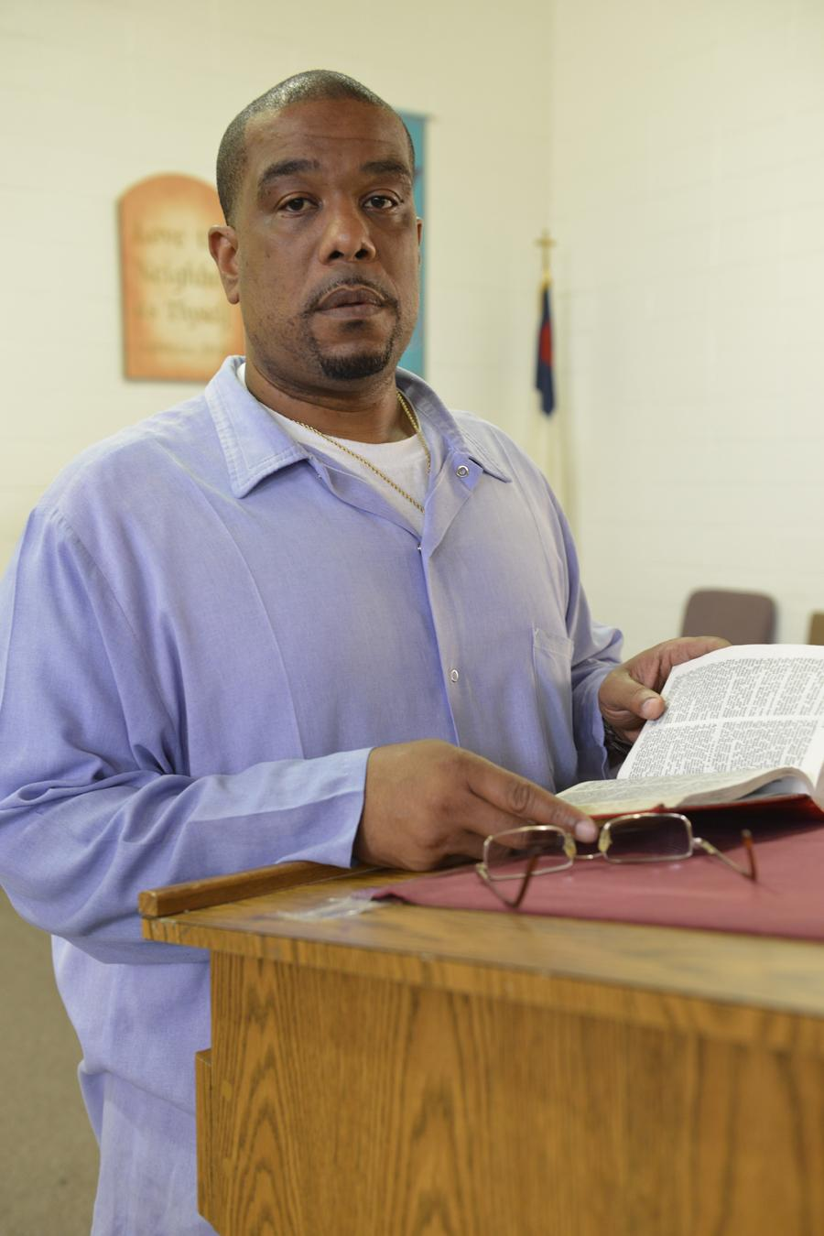
A young man asked if he could do a church service and we said sure ! You can teach next week.

Slide 36
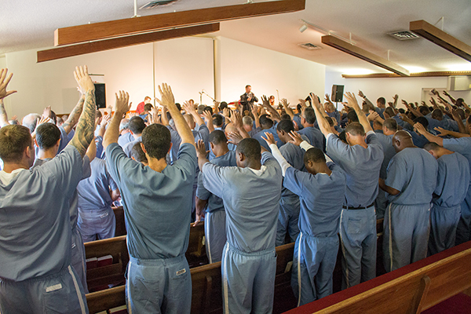
The subject of his bible study was about Christians going into the jails and prisons and sharing Gods word.

Slide 37
He said that most Christians do not know how to mentor new believers!!!!
WOW
I WAS BLOWN AWAY

Slide 38
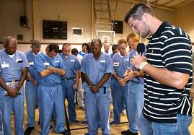
He said we take them through the “sinners prayer” give them all kinds of books to read! Tell them a whole list of do’s and don’ts .

Slide 39
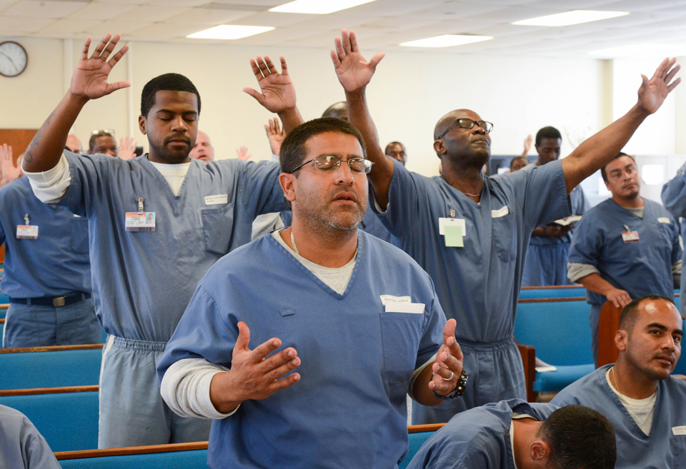
He said that’s not true mentoring!!! And that’s why so many new believers stumble.
What is the missing piece?

Slide 40
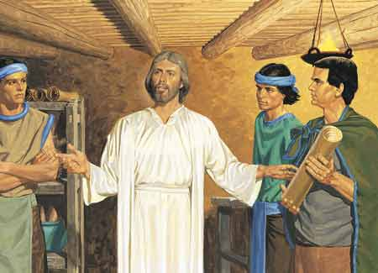

Slide 41
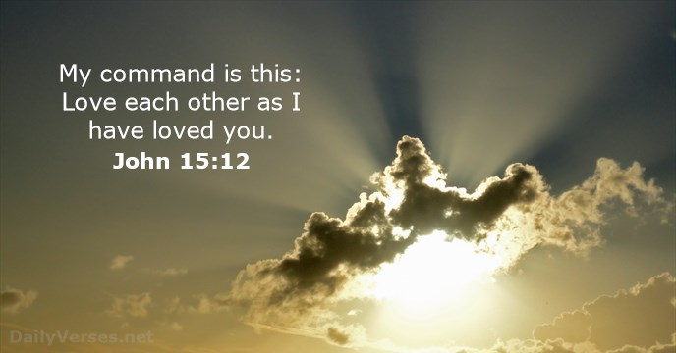

Slide 42

True mentoring is to LOVE one another

Slide 43
Point one
Trust JESUS to take care of your Giants
Point two
True mentoring is sharing the love of JESUS

